Slide 1
FAKULTAS TEKNOLOGI INFORMASI
ANALISIS TEKS PADA MEDIA SOSIAL
[KP398 – 2 SKS – S1 TEKNIK INFORMATIKA]

Slide 2
SOCIAL MEDIA Network Analytics: CENTRALITY
Pertemuan 14

Slide 3

14
Analisis Teks pada Media Sosial
S1 Teknik Informatika
Social Media Network Analytics
NETWORK PROPERTIES
Dr. Achmad Solichin, S.Kom., M.T.I.
Universitas Budi Luhur

Slide 4
Tujuan Pembelajaran
Mahasiswa dapat memahami dan menjelaskan secara konseptual dan praktis mengenai pengukuran centrality dalam konteks social media network analysis.

Slide 5
Remember: Social Media Network Analytics
Social network analysis (SNA) is the process of investigating social structures through the use of networks and graph theory (Otte & Rousseau, 2002). It characterizes networked structures in terms of nodes (individual actors, people, or things within the network) and the ties, edges, or links (relationships or interactions) that connect them.
Social network analysis is the science of studying and understanding social networks (Hanneman and Riddle 2005) and social networking.
Social media network analytics deals with constructing, analyzing, and understanding social media networks (Gohar F. Khan, 2015)

Slide 6
Social Network data
In general, a relation can be:
Undirected / Directed
Binary / Valued
b
d
b
d
a
c
e
a
c
e
Undirected, binary
Directed, binary
b
d
b
d
1
3
1
2
a
c
4
e
a
c
e
Undirected, Valued
Directed, Valued

Slide 7
Social Network data
Basic Data Structures
From pictures to matrices
b
d
b
d
a
c
e
a
c
e
Undirected, binary
Directed, binary
a
b
c
d
e
a
b
c
d
e
a
1
a
1
b
1
1
b
1
c
1
1
1
c
1
1
1
d
1
1
d
e
1
1
e
1
1

Slide 8
Social Network data
Basic Data Structures
From matrices to lists
a
b
c
d
e
Arc List
Adjacency List
a
1
a b
b a
b c
c b
c d
c e
d c
d e
e c
e d
b
1
1
a b
b a c
c b d e
d c e
e c d
c
1
1
1
d
1
1
e
1
1

Slide 9
Measuring Networks
Connectivity
Indirect connections are what make networks systems. One actor can reach another if there is a path in the graph connecting them.
b
d
a
b
f
a
c
e
c
f
d
e

Slide 10
Measuring Networks
Connectivity
Basic elements:
A path is a sequence of nodes and edges starting with one node and ending with another, tracing the indirect connection between the two. On a path, you never go backwards or revisit the same node twice.
Example: a → b → c→d
A walk is any sequence of nodes and edges, and may go backwards. Example: a → b → c → b →c →d
A cycle is a path that starts and ends with the same node.
Example: a → b → c → a

Slide 11
Common Network Properties
Node Level
Network level
Degree centrality
Betweenness centrality
Eigenvector centrality
Structural holes
Clustering coefficient
Density
Diameter
Average degree
Components

Slide 12
Centrality
Centrality
Centrality refers to (one dimension of) location, identifying where an actor resides in a network.
Centrality is fairly straight forward: we want to identify which nodes are in the ‘center’ of the network. In the sense that they have many and important connections.
Three standard centrality measures capture a wide range of “importance” in a network:
Degree
Closeness
Betweenness

Slide 13
Degree Centrality
Degree centrality of a node in a network measures the number of links a node has to other nodes (Hanneman and Riddle 2005).
Example:
Facebook → the number friendship ties a user has.
Twitter → the number of followers a user has.
In a directed network, degree can be either in-degree or out-degree. Indegree is the number of incoming links a node in a network receives.
For example, in a Twitter network, in-degree represents the number of followers a person has. Out-degree represents that number of out links a node sends. In a Twitter network, for example, the number of people a person follows represents out-degree of a person (node).

Slide 14
Degree Centrality
Degree Centrality:
Relative measure of Degree Centrality:

Slide 15
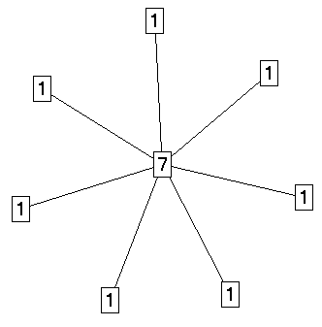
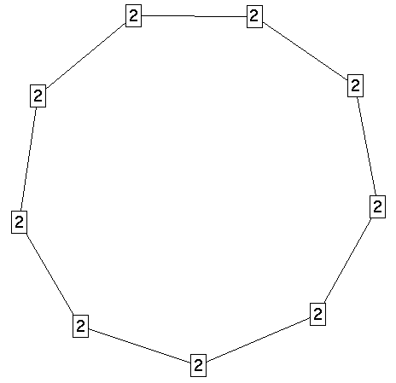
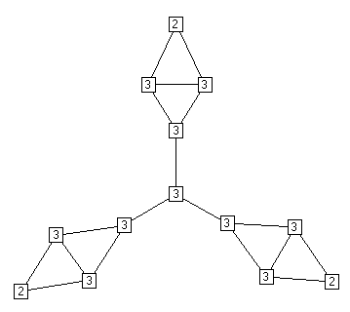
Degree Centrality

Slide 16
Degree Centrality: Let's practice
InDirected Network
1
3
2
5
6
4

Slide 17
Degree Centrality: Let's practice
Directed Network
1
2
3
5
6
4
7
8

Slide 18
Closeness Centrality
A second measure is closeness centrality. An actor is considered important if he/she is relatively close to all other actors.
Closeness is based on the inverse of the distance of each actor to every other actor in the network.
Closeness Centrality:
Relative Closeness Centrality

Slide 19
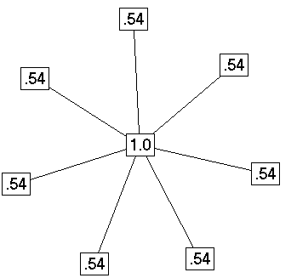
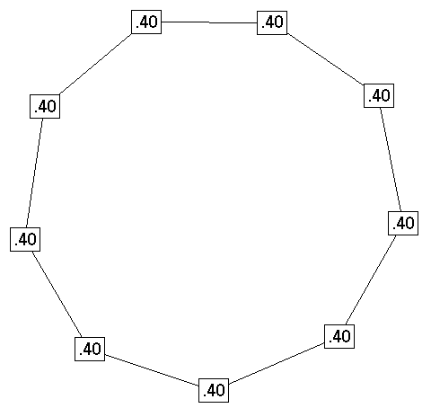
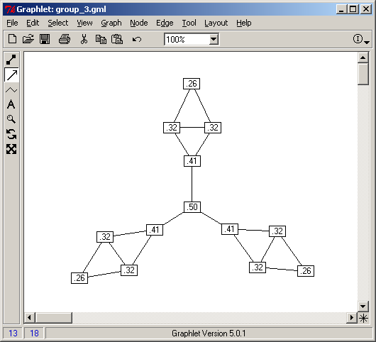
Closeness Centrality

Slide 20
Closeness Centrality: Let’s Practice
InDirected Network
1
3
2
5
6
4

Slide 21
Closeness Centrality: Let’s Practice
Directed Network
1
2
3
5
6
4
7
8

Slide 22
Betweenness Centrality
Definition: Betweenness centrality measures the number of times a node lies on the shortest path between other nodes.
What it tells us: This measure shows which nodes are ‘bridges’ between nodes in a network. It does this by identifying all the shortest paths and then counting how many times each node falls on one.
When to use it: For finding the individuals who influence the flow around a system.
A bit more detail: Betweenness is useful for analyzing communication dynamics, but should be used with care. A high betweenness count could indicate someone holds authority over disparate clusters in a network, or just that they are on the periphery of both clusters.

Slide 23
Betweenness Centrality
It measures the percentage of shortest paths where our studied node lies in them.
Thus a node with high betweenness centrality may have considerable influence over the information passing between other nodes. and so they represent a critical part of your network since removing them will disrupt links between vertices (nodes ) in your graph

Slide 24
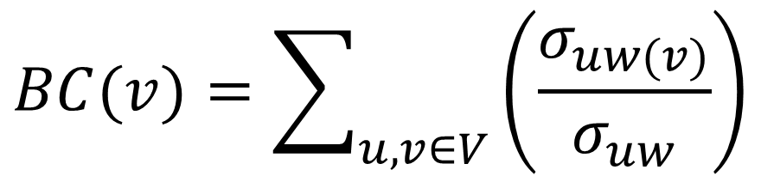
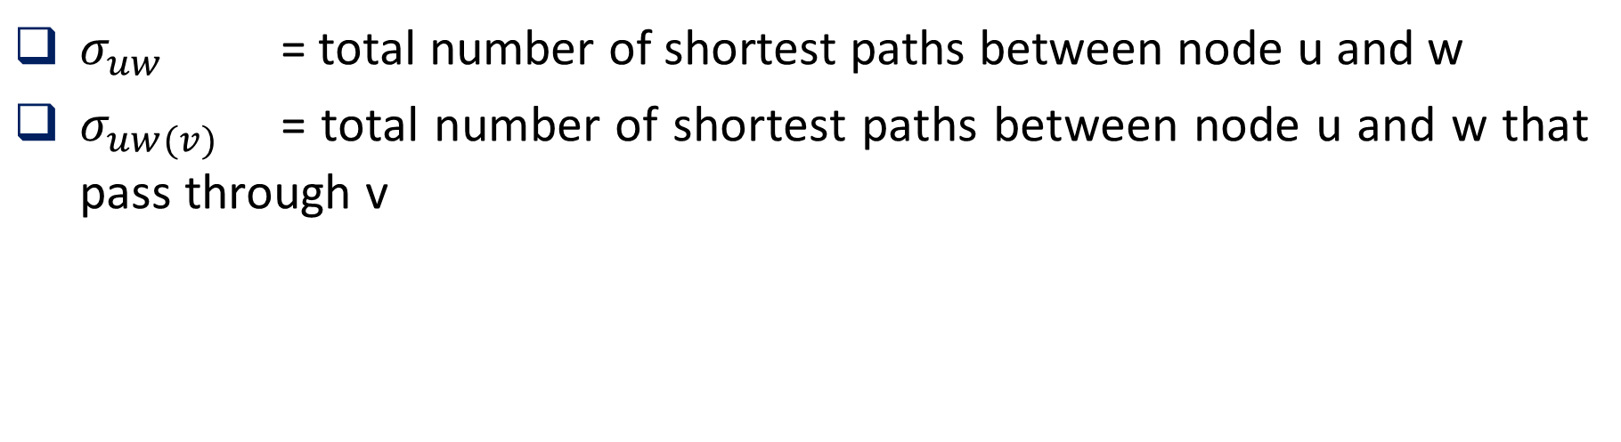
Betweenness Centrality
$$BC(v)=\sum_{u,v∈V}{\left(\frac{σ_{uw(v)}}{σ_{uw}}\right)}$$
$σ_{uw}$ = total number of shortest paths between node u and w
$σ_{uw(v)}$ = total number of shortest paths between node u and w that pass through v

Slide 25
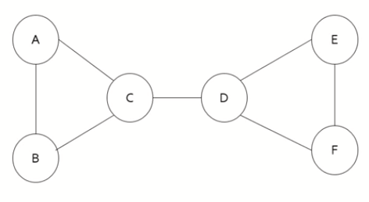
Betweenness Centrality: Example
Calculate the betweenness centrality for node C!
Source: https://youtu.be/ptqt2zr9ZRE

Slide 26
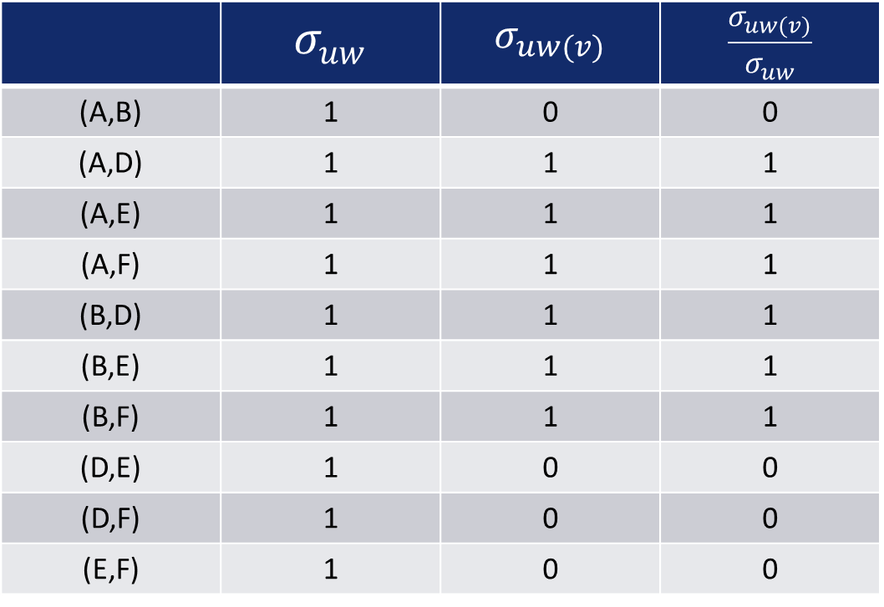
Betweenness Centrality: Example
Calculate the betweenness centrality for node C!
 | $$σ_{uw}$$ | $$σ_{uw(v)}$$ | $$\frac{σ_{uw(v)}}{σ_{uw}}$$
(A,B) | 1 | 0 | 0
(A,D) | 1 | 1 | 1
(A,E) | 1 | 1 | 1
(A,F) | 1 | 1 | 1
(B,D) | 1 | 1 | 1
(B,E) | 1 | 1 | 1
(B,F) | 1 | 1 | 1
(D,E) | 1 | 0 | 0
(D,F) | 1 | 0 | 0
(E,F) | 1 | 0 | 0

Slide 27
Betweenness Centrality: Example
Calculate the betweenness centrality for node C!
 | $$σ_{uw}$$ | $$σ_{uw(v)}$$ | $$\frac{σ_{uw(v)}}{σ_{uw}}$$
(A,B) | 1 | 0 | 0
(A,D) | 1 | 1 | 1
(A,E) | 1 | 1 | 1
(A,F) | 1 | 1 | 1
(B,D) | 1 | 1 | 1
(B,E) | 1 | 1 | 1
(B,F) | 1 | 1 | 1
(D,E) | 1 | 0 | 0
(D,F) | 1 | 0 | 0
(E,F) | 1 | 0 | 0
The betweenness centrality for node C is 6
6

Slide 28
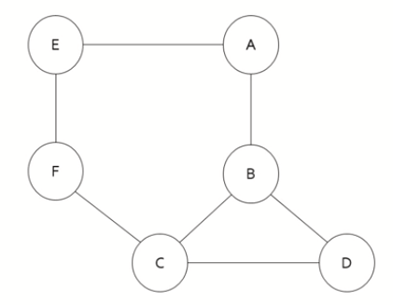
Betweenness Centrality: Practice!

Slide 29
Centrality: What it’s mean?
 | Low Degree | Low Closeness | Low Betweennes
High Degree |  | Embedded in cluster that is far from the rest of the network | Ego's connections are redundant - communication bypasses him/her
High Closeness | Key player tied to important / active alters |  | Probably multiple paths in the network, ego is near many people, but so are many others
High Betweennes | Ego's few ties are crucial for network flow | Very rare cell. Would mean that ego monopolizes the ties from a small number of people to many others.

Slide 30
Node-Level Properties: Eigenvector Centrality
Eigenvector centrality measures the importance of a node based on its connections with other important nodes in a network.
It can provide an understanding of a node’s networking ability relative to that of others (Marsden, 2008).
Eigenvector Centrality Calculation: https://youtu.be/Fr-KK8Ks5vg

Slide 31


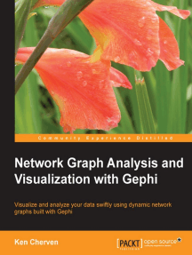


References / Books

Slide 32
Kontributor Materi
Dr. Achmad Solichin, S.Kom., M.T.I (Universitas Budi Luhur, achmad.solichin@budiluhur.ac.id) – pembuat awal.
(silahkan tambahkan nama Anda jika mengubah bahan kuliah ini)

Slide 33


Kesimpulan
TERIMA KASIH

